Slide 1


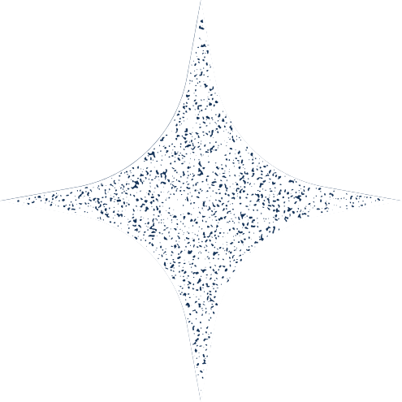
DSA Project
ON GEMSEC DEEZER DATASET(PUBLIC DATASET)

Slide 2

Group Members
22bds061 Vansh Lal Tolani
22bds050 R Niharika
22bds018 Dhrithi K
22bds024 G Leeladitya

Slide 3
Case 1 Data Structure Project
Multi-Layer Transport Network
There are three graphs G1, G2, G3
G1 represents Train-ways
G2 represents Road-ways
G3 represents Rail-ways
Each graph has 6 vertices representing a city and undirected weighted edges representing the city-connections.

Slide 4

Graph G1 has 6 vertices and 6 edges connecting these vertices.
Similarly, Graph G2 has 6 vertices and 8 edges.
And, Graph G3 has 6 vertices and 9 edges.

Slide 5
Prims and Kruskal Algorithms are used to calculate Minimum Spanning Trees from the Graph Dataset
While BellmanFord and Dijkstra Algorithms are used for the calculation of Shortest paths from one node to another

Slide 6
Prim's and Kruskal's Algorithms: The output of running the algorithm was the MST of each graph G1, G2, G3 and their edge weights were taken to calculate the mean, median, maximum and minimum values.
2. Dijkstra's and Bellman-Ford's Algorithms: Shortest paths from the source node (taken as vertex 0) to each vertex was given as the output and shortest path weights were used to find the values of mean, median, maximum and minimum.

Slide 7
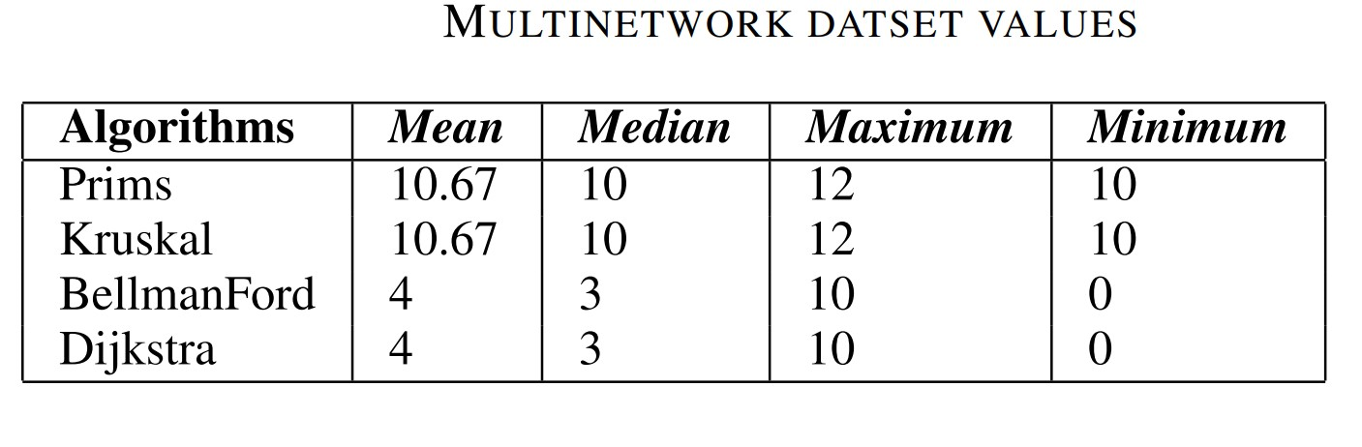
The below results have been obtained after running the four algorithms on the data from the graphs.

Slide 8
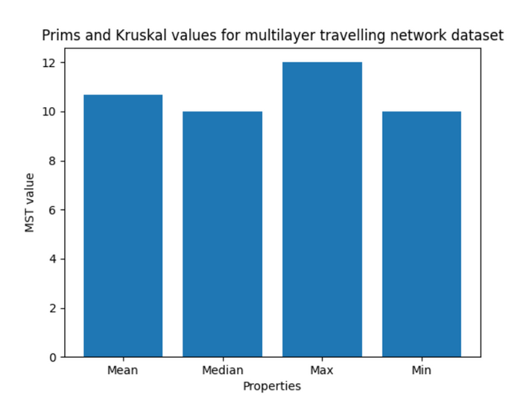
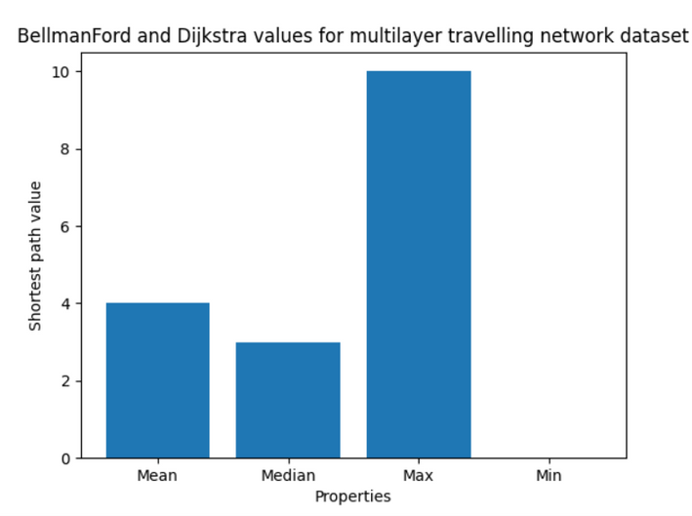
Visualization of the values of multilayer travelling network

Slide 9
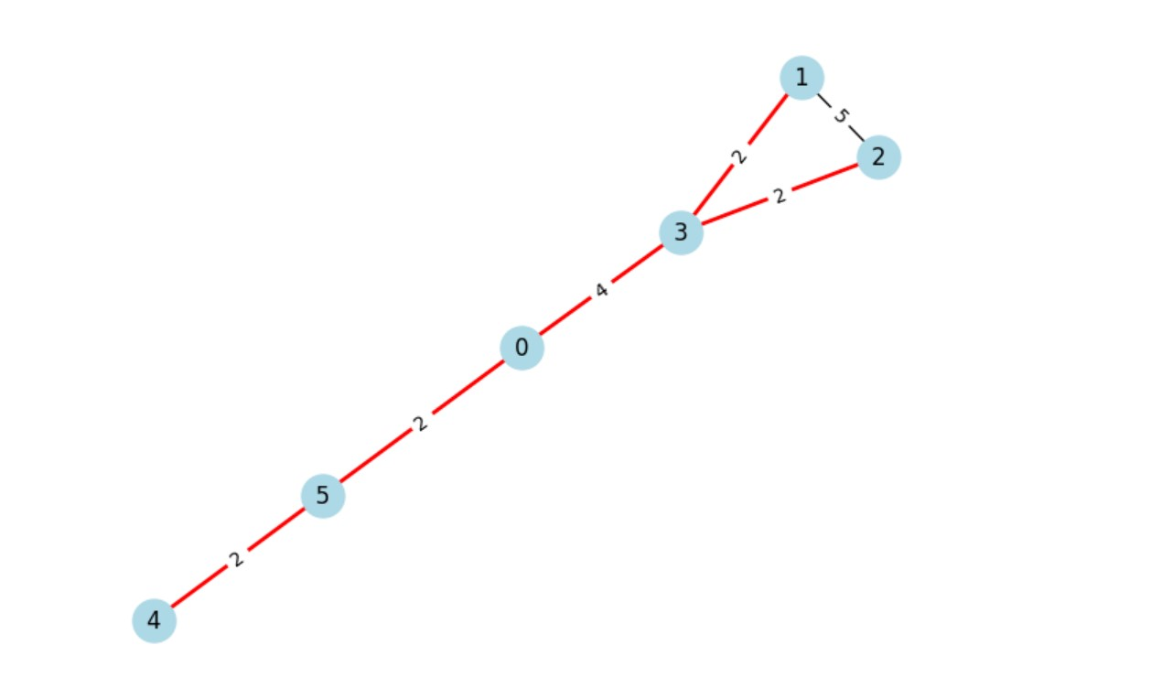
Extras: Graph representation of the data of vertices and edges was done in python language to get the visual representations of the graphs.
Graph G1
output
visual representation of Graph G1

Slide 10
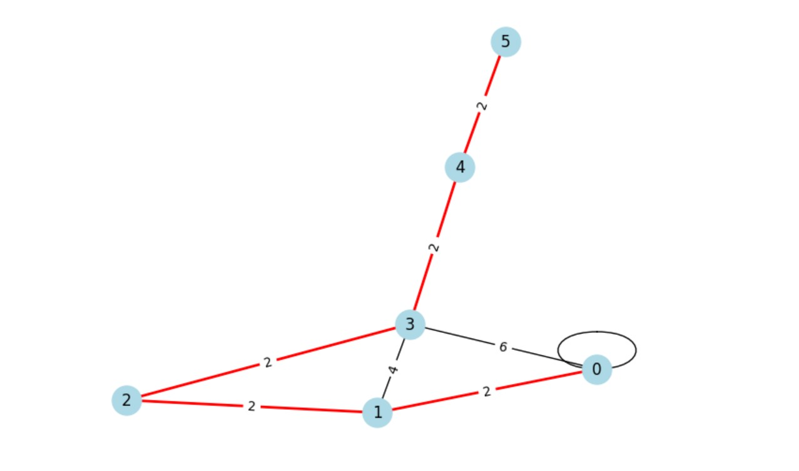
Graph G2 output
Visual representation of Graph G2

Slide 11
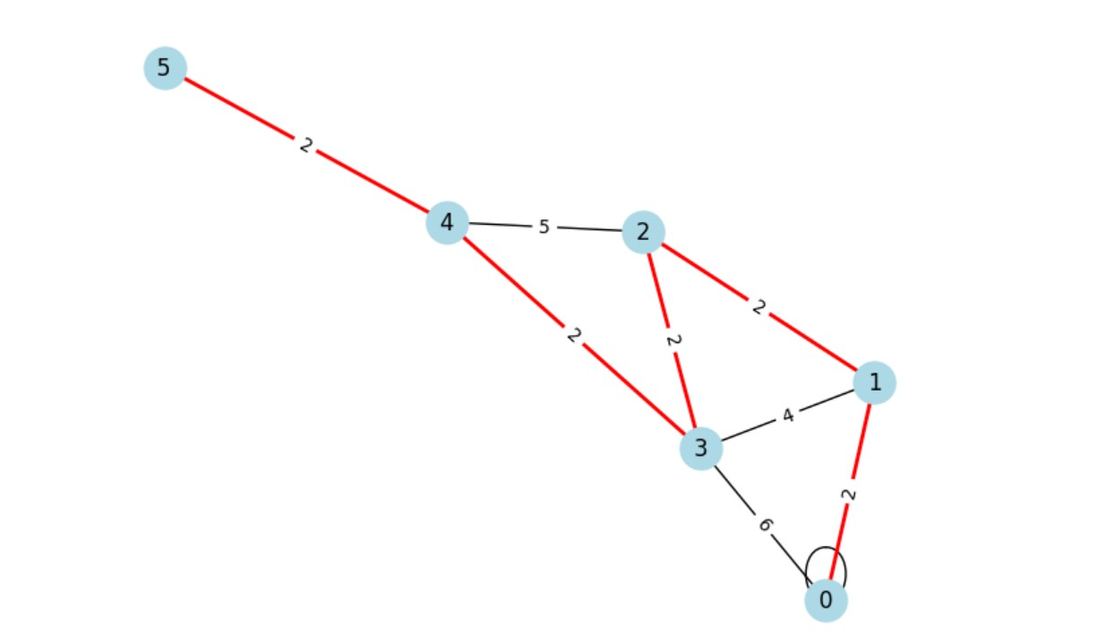
Graph G3
output
Visual representation of Graph G3

Slide 12
GEMSEC DEEZER IS A PART OF SOCIAL NETWORK DATSET

Slide 13
SNAP Public Data set Project Case 2
GEMSEC-Deezer
GEMSEC-Deezer dataset was applied various graph algorithms.
The dataset consists of social networks of users from three European nations, represented as nodes, with mutual follower relationships as edges.
The main focus of the analysis is to compare and discuss the performance of four algorithms: Prims, Kruskal, Bellman Ford, and Dijkstra.
The algorithms are applied to find Minimum Spanning Trees (MSTs) and shortest pathways in the multi-layer graph. Additionally, statistical measures such as mean, median, maximum, and minimum are computed for the MSTs of the graph.

Slide 14
Brief about GEMSEC as mentioned in the Research paper
GEMSEC, a graph embedding algorithm that addresses the problem of community detection in networks. Community detection involves identifying groups of nodes in a network that are more densely connected to each other than to the rest of the network. GEMSEC is designed to simultaneously learn node embeddings and cluster nodes into communities, thereby leveraging the benefits of both tasks.
GEMSEC is a novel approach that combines graph embedding and community detection, offering valuable insights into network structures and enhancing the quality of detected communities.

Slide 15
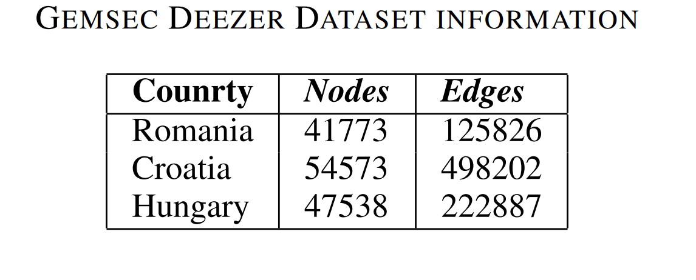
Description of the Dataset :
The following table gives the number of nodes i.e.; the users of Deezer, which is a music streaming service and edges, which is the mutual follower relationships. The data is from three different European countries.

Slide 16
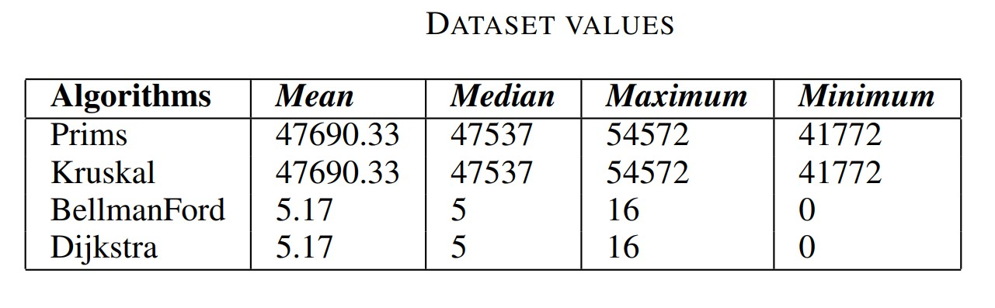
The below results have been obtained after running the Prim's, Kruskal's , Dijkstra's and Bellman-Ford's algorithms on the dataset from SNAP.

Slide 17
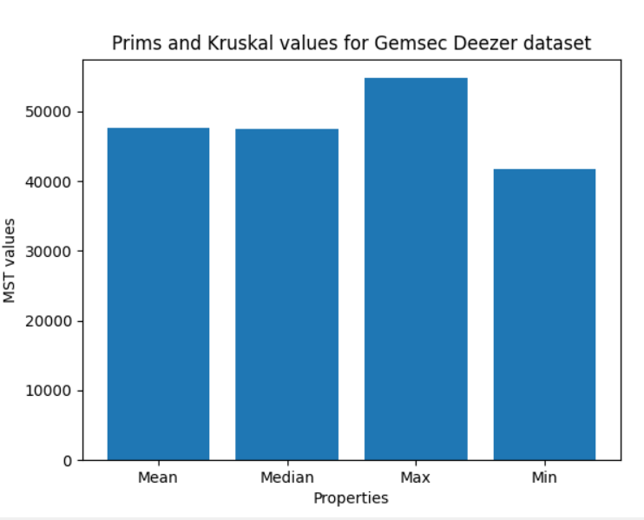
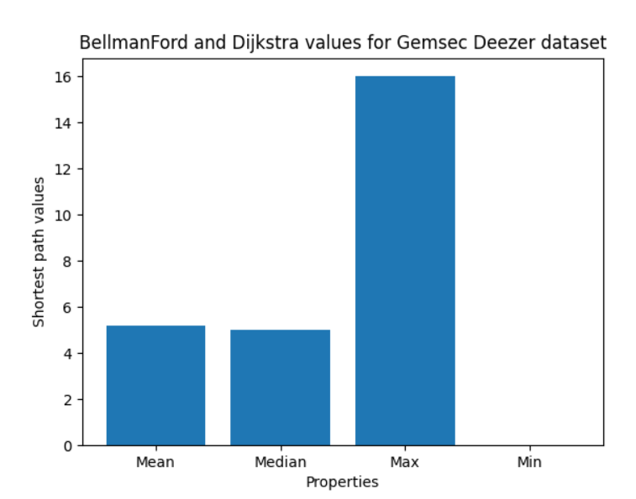

Slide 18
Approach used for calculation of various properties using the 4 algorithms
1.For Prims and Kruskal Algorithm
First we took three datsets of Gemsec Deezer and then imported in the Prims and Kruskal Algorithm and then we first printed the individual MSTs of three datasets.
In the second step,we added a code to calculate the combine mean,median,and compare all the three MSTs to find maximum,minimum of all three MSTs of the dataset.

Slide 19
And that gave us the information about mutual users using a particular Music service

Slide 20
2.For BellmanFord and Dijkstra Algorithm
First we took three datsets of Gemsec Deezer and then imported in the BellmanFord and Dijkstra Algorithm and then we first printed the individual relationships between mutual user using the same music service.
In the second step,we added a code to calculate the combine mean,median and compare all the three relationships between mutual users using same music service to find maximum,minimum of all three of the dataset.

Slide 21
How are results different from the research paper
In the research paper, GEMSEC algorithm is used to simultaneously perform node embedding and community detection on social network graphs. Community detection is an important problem in network analysis, finding groups of nodes that are more densely connected to each other than to the rest of the network.

Slide 22
But according to the project done, the MST of the given data set of the users and the shortest path was found by the application of the algorithms. Here, the MST edges may represent the possible relationships between all the users of Deezer(cause in MST all the nodes are connected) and Shortest path represents the characteristics of connections between the users (like how well any two users music preferences match).

Slide 23
GitHub link
https://github.com/Niharika0804/DSA-Project-Case1.git
https://github.com/Niharika0804/DSA-Project-Case2.git
https://github.com/Niharika0804/Lab11DSA.git

Slide 24
References
1.https://arxiv.org/pdf/1802.03997.pdf
2.https://snap.stanford.edu/data/gemsec-Deezer.html
3.https://algs4.cs.princeton.edu/43mst/PrimMST.java.html
4.https://algs4.cs.princeton.edu/43mst/KruskalMST.java.html
5.https://algs4.cs.princeton.edu/44sp/DijkstraSP.java.html
6.https://algs4.cs.princeton.edu/44sp/BellmanFordSP.java.htm

Slide 25
Thank you!

